Slide 1
introducing vinniQ/quickQ
Ask Anything!
Notes:
This presentation demonstrates the new capabilities of PowerPoint and it is best viewed in Slide Show. These slides are designed to give you great ideas for the presentations you’ll create in PowerPoint 2010!
For more sample templates, click the File tab, and then on the New tab, click Sample Templates.

Slide 2
Enhancing Your Presentation
1
2
3
Author Your
Presentation
Enrich Your
Presentation
Deliver Your
Presentation
We have features for every step of the way

Slide 3
Author Your Presentation
1
Design, organize, and collaborate

Slide 4
?
ask
search the list of qs
Process
If answer is valid
Transmit to users who will answer

Slide 5



Getting Started with Templates
Incentivize Customers
For valid answers give points/benefits/cash rewards/discounts
For giving rating
give points/benefits/cash rewards/discounts
Use sample templates to kick-off your presentation and focus on the content (you’re viewing one right now!)

Slide 6

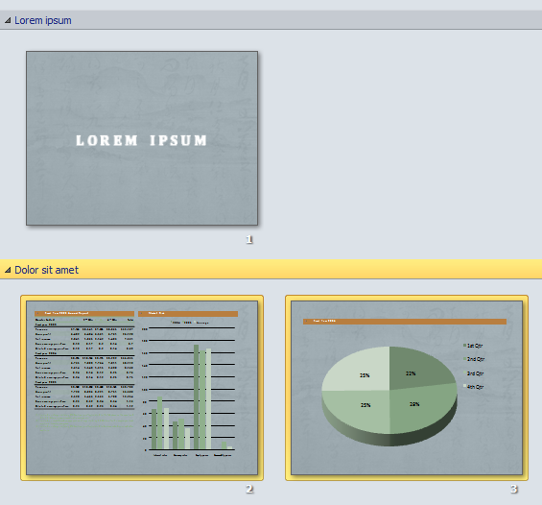
Too much information?
Divide and conquer a large presentation by organizing your presentation with sections.
Organize with Sections
You can name, print, and apply effects to an entire section easily.

Slide 7





Collaboration
Simultaneous edits on one single document. No more waiting your turn or managing multiple versions.
It’s about team work, and co-authoring will get you there.

Slide 8

Enrich Your Presentation
2
Stylize, edit, and animate your media

Slide 9


YOUR MESSAGE.
It’s not just about the visuals, but strengthening

Slide 10



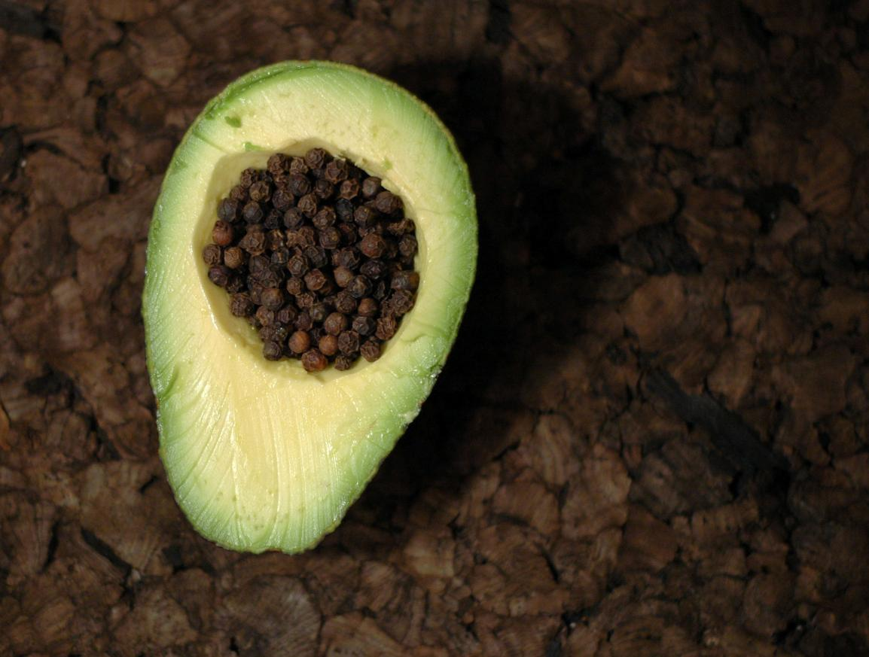

New Picture Effects
Picture Color, Corrections, Artistic Effects,
and Background Removal allow you to customize images for your story

Slide 11




Animate This
Check out this animation:
With the Animation Painter
you can re-create the same animation with one click

Slide 12


Video Perfect
You can do a lot more with videos in PowerPoint 2010.
Videos can be embedded in your presentation. That’s right, no more lost videos!
Also, you can recolor the entire video or apply a video style easily. Your videos will look great!

Slide 13
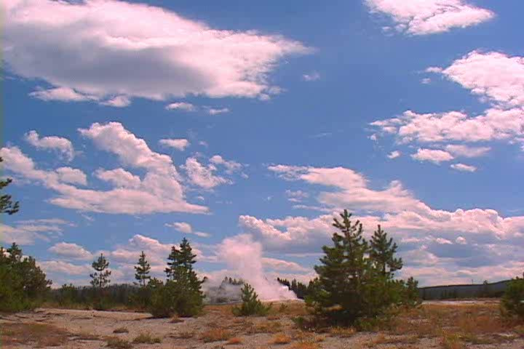
Fountain Geyser
Want to jump to a bookmark in your video? Hover over the video and you’ll be pleasantly surprised.
Did we mention you can add bookmarks, include fades, and trim your videos now?

Slide 14
What about the beautiful transitions you’ve been seeing?
Exciting new transitions
They are new too.

Slide 15
Deliver Your Presentation
3
Broadcast and compress for seamless delivery

Slide 16










BROADCAST IT
Show and tell your presentation with Broadcast Slide Show
Share your presentation in real-time with anyone with a browser, directly from PowerPoint.
You’ll never have to say, “Next slide, please” again!

Slide 17

SPEAK FOR ITSELF
Let Your Presentation
Record your presentation with Create a Video and capture narrations, animations, media, and much more.
Upload, embed, and share away!

Slide 18


Spread the Message!
For a media-rich presentation, you can Optimize for Compatibility
or Compress Media to share your presentation reliably without exploding your inbox
Package your presentation
for easy sharing

Slide 19
But wait… There’s More!
?
View your slides from anywhere!

Slide 20

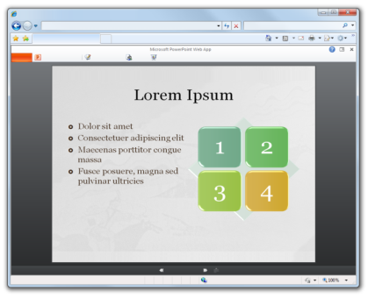

Access Anywhere
Check out the
PowerPoint Web App
Access slides wherever you are

Slide 21





POWERPOINT 2010
What’s Your Message?

